Slide 1


7143CEM Lecture 3: Week 5 Overview
School of Computing, Electronics and Mathematics Coventry University
7143CEM Programming for Data Science 2021/22 Semester 2

Slide 2
Intended Learning Outcomes
Demonstrate critical knowledge and systematic understanding of essential concepts of data science and computer programming.
Design, build, test, adapt and critique small programs in a high-level programming language.
Critically assess, select and apply data science tools, libraries or algorithms appropriate for various phases of the data science project lifecycle.
Notes:
We have already covered ILO2 so far in the module.

Slide 3
Week 5 – Monday
Data Science overview, lifecycle and applications
What is Data Science and what does a Data Scientist do?
Relationship to business intelligence, statistics, data analysis/analytics, databases, data engineering, big data, machine learning, computational intelligence, data visualisation and scientific computing.
Applications of Data Science, including text mining (twitter), classification, and recommender systems.

Slide 4
Week 5 – Tuesday
Big Data
What is Big Data and where does it come from?
Drivers of Big Data (what causes it to be possible).
Big Data Solutions (distributed systems, “the cloud” and NoSQL databases).
Big Data technology (Apache Hadoop and MapReduce).
More in 7082 Big Data Management and Data Visualisation

Slide 5
Week 5 – Wednesday
Catchup and Support
Absolute beginners (aimed at late starters)
Anaconda, Spyder, Jupyter
Python programming (Week 1)
Data Science libraries (Week 3)
One-to-one or small group support
Help with debugging and technical issues
Portfolio support and encouragement

Slide 6
Week 5 – Thursday
Data Protection and Data Ethics
Legal issues: data ownership, rights of data subjects (consent), access to data.
Social and ethical issues: unfair discrimination, reinforcement of human biases and data biases, lack of transparency, accountability, code of conduct.
Data security and data leaks – how it can all go wrong (film trailer: “The Great Hack”)

Slide 7
Week 5 – Fun Friday
Review (of this week) and Preview (of 7144CEM)
Data science, big data, data protection and data ethics
Portfolio (outline of Task 4)
Preview of 7144CEM Principles of Data Science
Linear algebra and probability (numpy/scipy)
R/RStudio and the tidyverse
Linear regression and multivariate data analysis
Brief introduction to Matlab and Octave

Slide 8
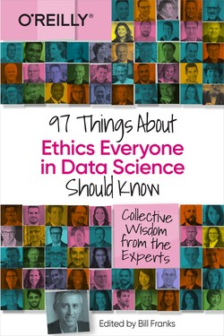
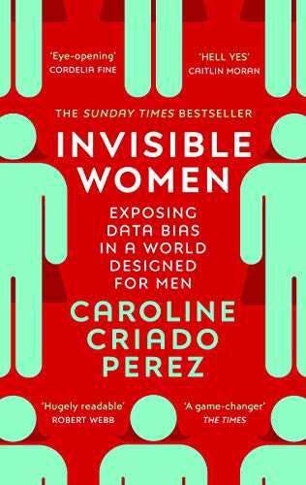
Recommended reading
Bill Franks (ed). 97 Things About Ethics Everyone in Data Science Should Know, O’Reilly, 2020.
Caroline Criado Perez. Invisible Women: Exposing Data Bias in a World Designed for Men, Vintage, 2020.

